Slide 1
Domain III
Microeconomics Review

Slide 2
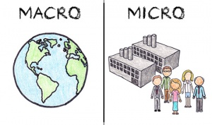
Define microeconomics

Slide 3
Concepts and skills dealing with human behavior and choices as they relate to the entire economy.

Slide 4
Define macroeconomics

Slide 5
Concepts and skills dealing with human behavior and choices as they relate to the entire economy.

Slide 6
Explain the product market

Slide 7
Consumers spend the income they earned to buy goods and services, that earns revenue for businesses

Slide 8
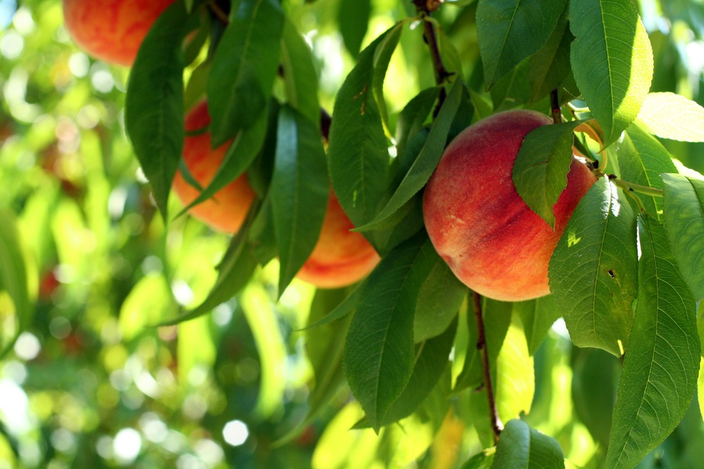
Explain the factor or resource market?

Slide 9
People sell their land, labor, capital, and business and businesses exchange for income payments

Slide 10
Explain the circular flow of goods and services?

Slide 11
Shows the interactions between buyers and sellers in different markets.

Slide 12
Which of the following represents letter A, B, C, D?

Slide 13
A: Products B: Income C: Factory market D: Businesses

Slide 14
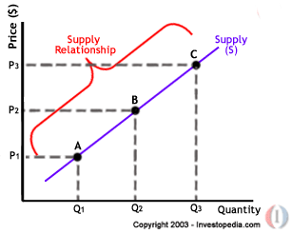
Define the law of supply

Slide 15
An economic principle stating that as price rises, the quantity a seller is willing and able to sell increases.

Slide 16
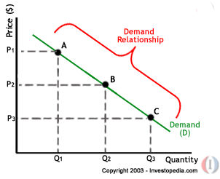
Define the law of demand

Slide 17
An economic principle stating that as the price of a good rises, the quantity of the good consumers are willing and able to buy decreases.

Slide 18
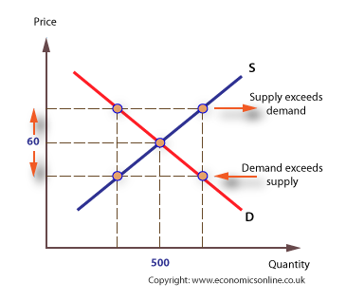
Explain market clearing price or equilibrium price

Slide 19
Found at the intersection of the market demand and supply curves. It is the point at which the quantity demanded by consumers is equal to the quantity supplied by producers.

Slide 20
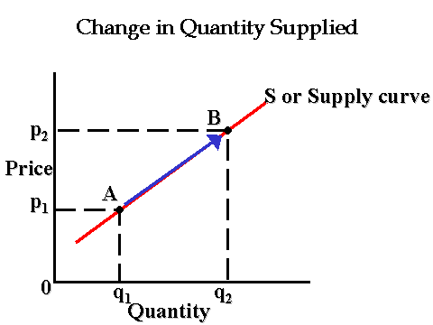
Explain change in quantity demand/supply

Slide 21
The amount of a good, service, or resource buyers/seller are willing and able to buy/sell at one specific price. Movement along the supply/demand curve.

Slide 22
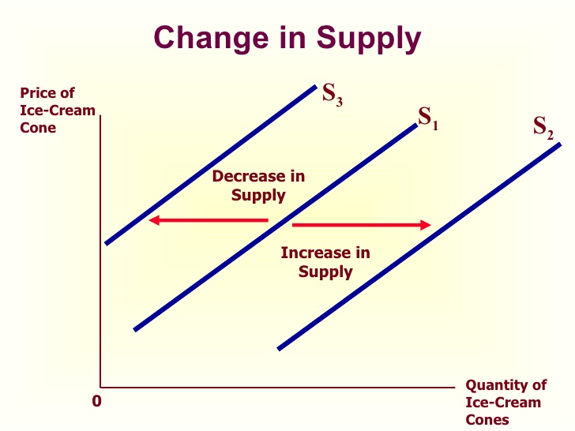
Explain change in demand/supply?

Slide 23
A change in the supply/demand of a good or service due to a change a determinant of supply/demand. A shift in the supply/demand curve.

Slide 24
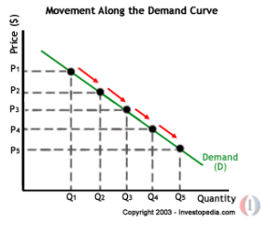
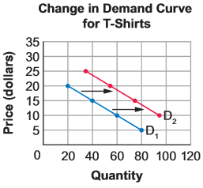
Which of the above graphs is a change in quantity demanded?
Graph A | Graph B

Slide 25
Graph A

Slide 26
Which of the above graphs is a change in demand?

Slide 27
Graph B

Slide 28
What are the 6 determinants or factors that cause supply to shift?

Slide 29
Costs of productive resources, government regulations, number of sellers, producer’s expectations, technology, education.

Slide 30
What are the 5 determinants or factors that cause demand to shift?

Slide 31
Related goods, income, consumer expectations, preferences/tastes, number of consumers

Slide 32
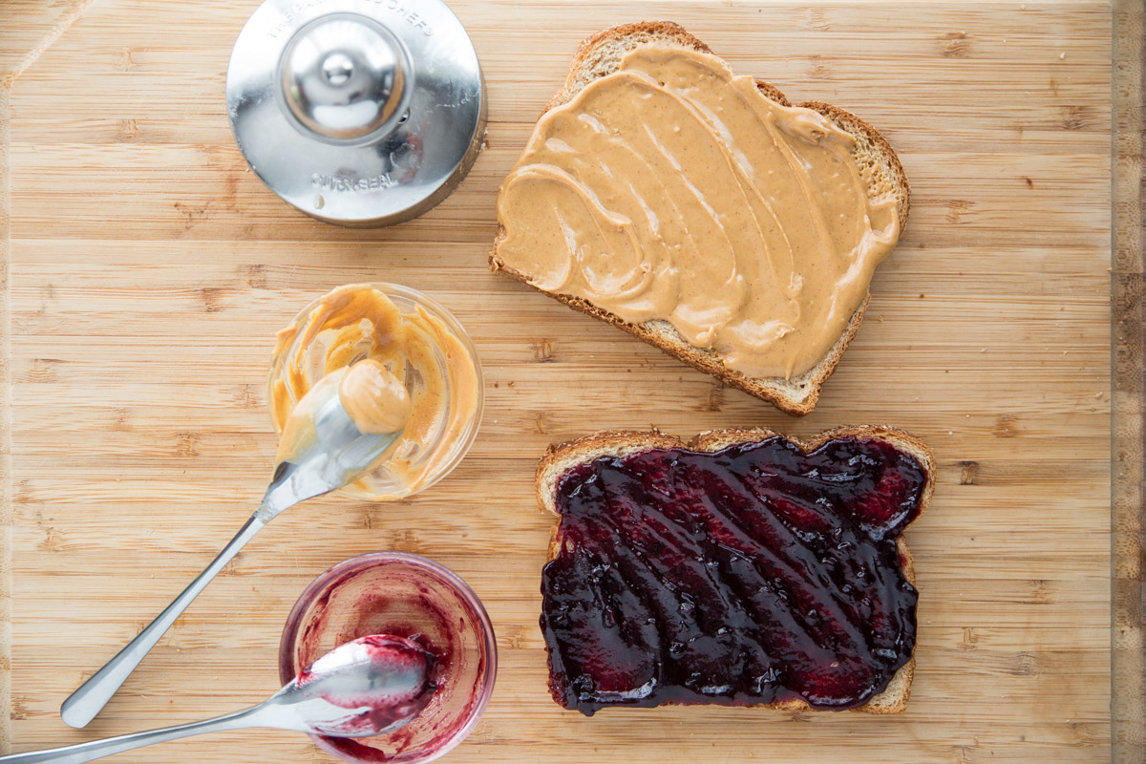
What is an example of a complementary good?

Slide 33
Peanut butter and jelly

Slide 34
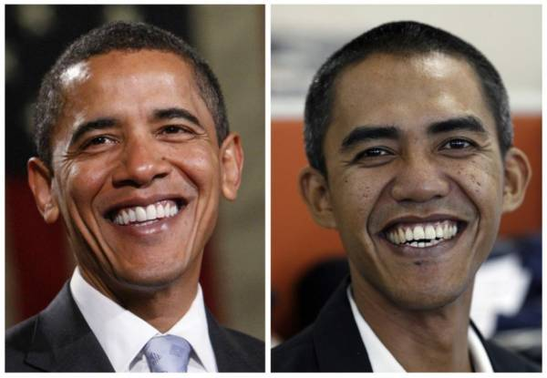
What is an example of a substitute good?

Slide 35
Coke and Pepsi

Slide 36
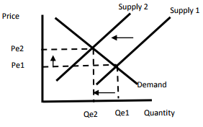
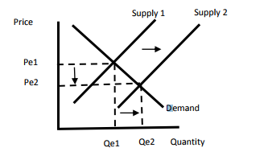
Which of the above graphs shows an increase in quantity supplied, decrease in price, and increase in supply?
Graph A | Graph B

Slide 37
Graph B

Slide 38
Which graph shows a decrease in quantity supplied, increase in price, and decrease in supply?

Slide 39
Graph A

Slide 40
Which of the above graphs shows what will happen to the supply of U.S. Cars if nationwide auto workers go on strike?

Slide 41
Graph A

Slide 42
Which of the above graphs shows what will happen to the supply of U.S. Cars if the cost of Steel decreases?

Slide 43
Graph B

Slide 44
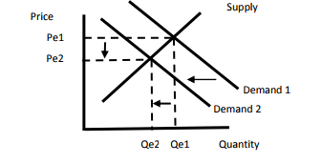
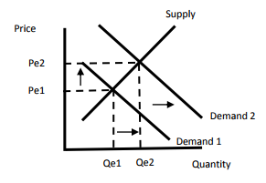
Which of the above graphs shows what will happen to the demand for U.S. cars if consumer’s income decreases?
Graph A | Graph B

Slide 45
Graph A

Slide 46
Which of the above graphs shows what will happen to the demand for U.S. cars if the price of foreign cars increases?

Slide 47
Graph B

Slide 48
Which of the above graphs shows what will happen to the demand for U.S. cars if the price of gas decreases?

Slide 49
Graph B

Slide 50
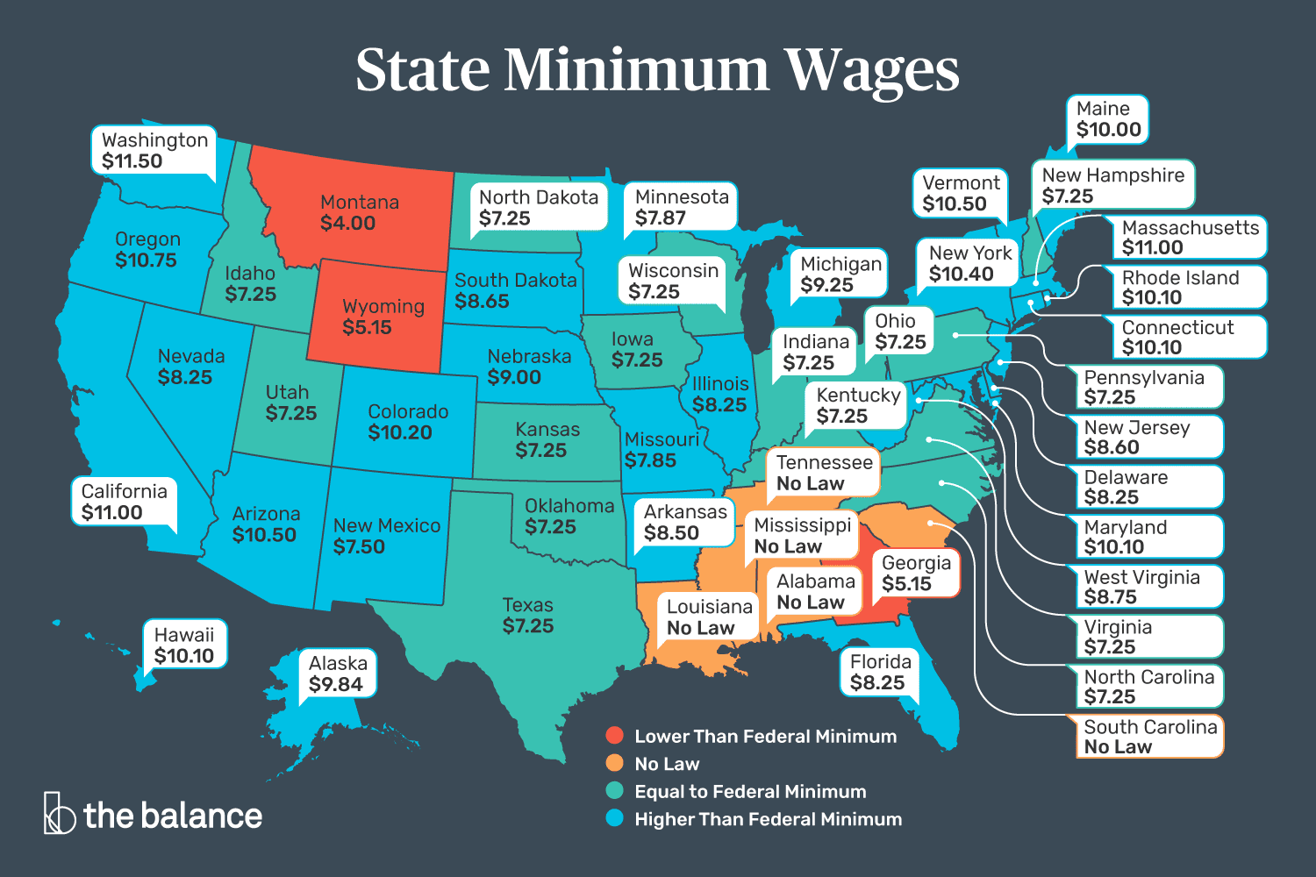
Which of the following best explains a price floor?

Slide 51
Minimum wage, rice above the equilibrium price, sets a minimum price for which a product can be sold

Slide 52
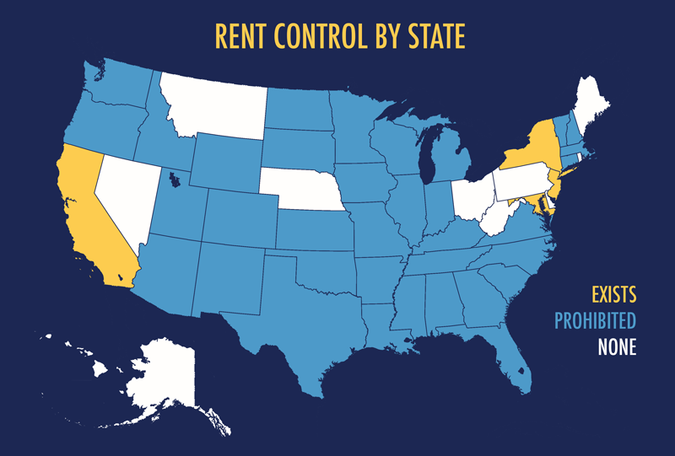
Which of the following best explains a price ceiling?

Slide 53
Rent control, price below the equilibrium price, sets a maximum price at which a good can be sold.

Slide 54
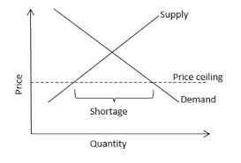
What do government price ceilings create?

Slide 55
Shortage

Slide 56
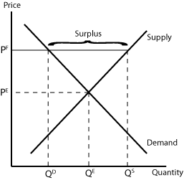
What do government price floors create?

Slide 57
Surplus

Slide 58
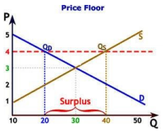
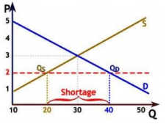
Which the above graphs best represents a price ceiling?
Graph A | Graph B

Slide 59
Graph B

Slide 60
Which of the above graphs best represents a price floor?
Graph A | Graph B

Slide 61
Graph A

Slide 62
What are the three types of business organizations?

Slide 63
Sole proprietorship, partnership, corporation

Slide 64
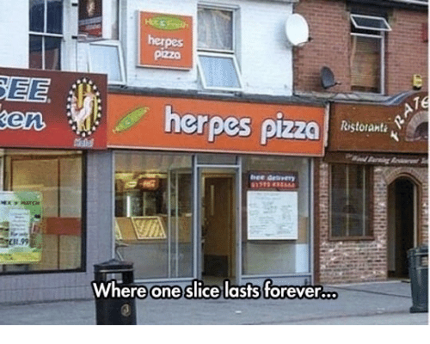
Explain a sole proprietorship

Slide 65
Limited life, limited funds, easy to start, owned by one person

Slide 66
Explain a partnership

Slide 67
Benefits from specialization, potential conflict, division of profits, owned by two or more people

Slide 68
Explain a corporation

Slide 69
Access to large amounts of funds, unlimited life, double taxation, owned by shareholders

Slide 70
What are the four types of market structures?

Slide 71
Oligopoly, monopoly, monopolistic competition, pure competition

Slide 72
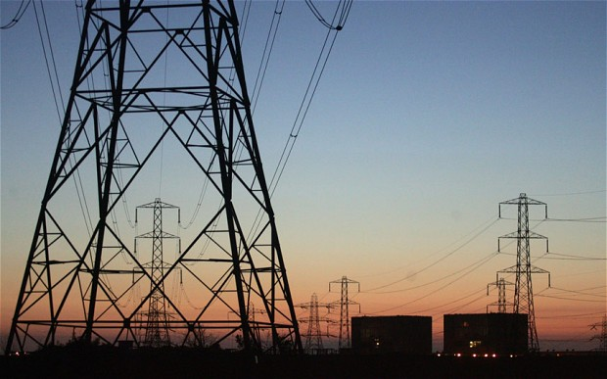
Explains a monopoly

Slide 73
Electric power and cable television companies, only one seller of a product dominating the market.

Slide 74
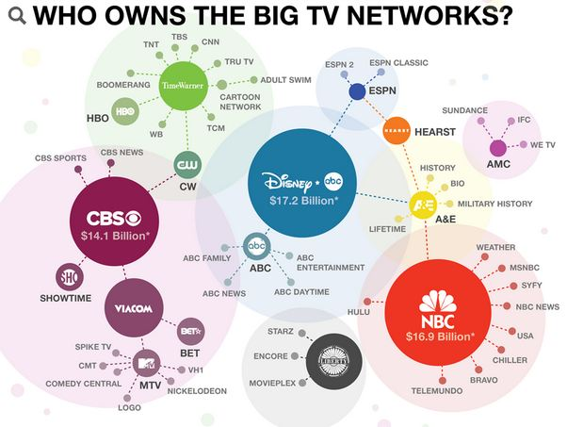
Explain an oligopoly

Slide 75
Breakfast cereals and soft drink companies, only a few sellers of a product who dominate the market.

Slide 76
Explain a monopolistic competition

Slide 77
Restaurants and retail clothing sellers, large number of buyers and sellers of products that are similar to one another be can be differentiated by brand, quality, etc.

Slide 78
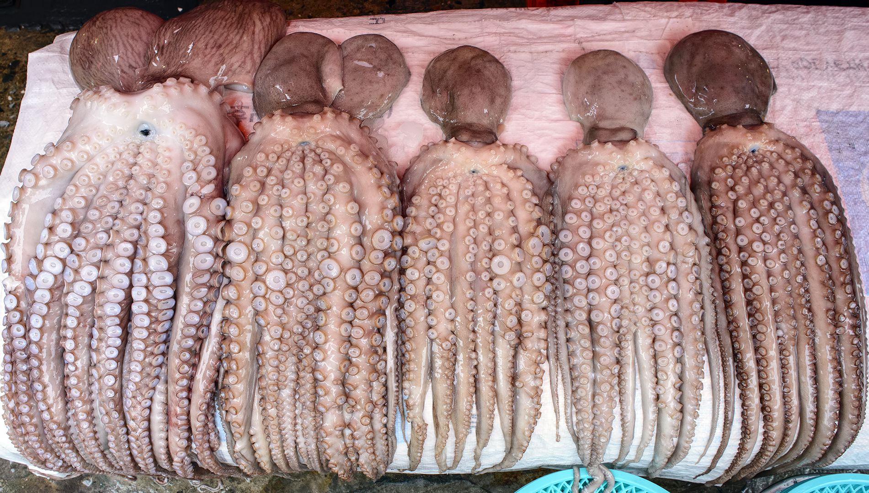
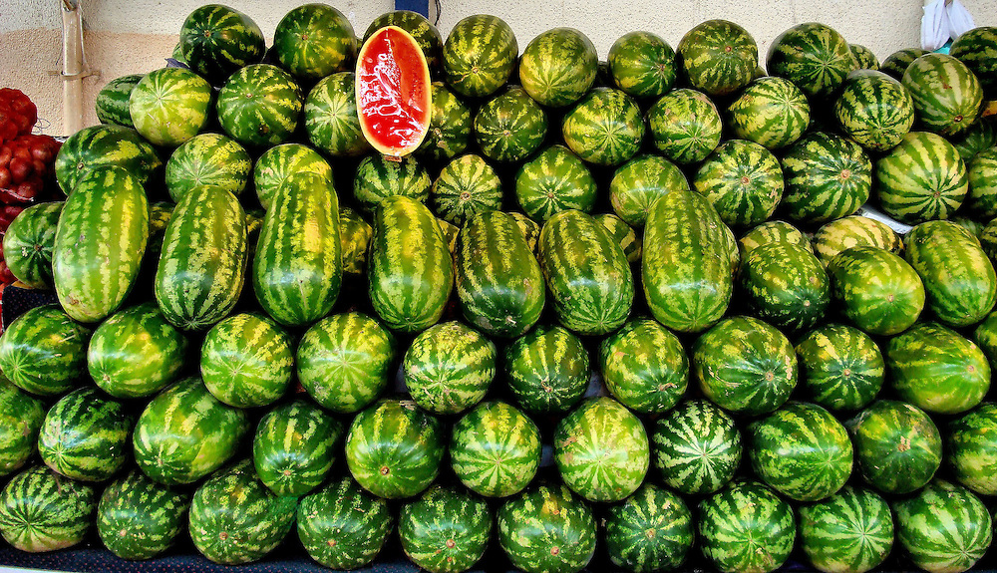
Explain a pure (perfect) competition

Slide 79
Farmers and oil producers, large number of buyer and sellers of an identical product.

Slide 80
Label A, B, C, and D
Types of Markets | Advertising | Barriers to Enter Market | Control over Prices | Types of Products
Market A | None | All most impossible | Complete | Unique, no substitute
Market B | Much | Difficult | Some | Some differences in products
Market C | Much | Fairly easy | Little | Similar but different
Market D | None | None | None | Similar or identical

Slide 81
Market A: Monopoly Market B: Oligopoly Market C: Monopolistic Competition Market D: Pure competition

